Slide 1

DriverPass System Analysis
Connie Knupp
Notes:
[No speaker notes required for this slide.]

Slide 2

System Requirements
Functional Requirements
The system will provide access to online learning material.
The system will allow users to chose between customizable packages.
The system will allow users to schedule driving lessons in 2-hour blocks.
Non-Functional Requirements
Accessibility – users can access from mobile devices or internet connected computers.
Speed – the system will have a less than 2 second response time to avoid user frustration.
Notes:
[In your speaker notes, include an explanation of the different requirements you determined for DriverPass’s system. What are the functional requirements you selected to describe? What are the nonfunctional requirements you selected to describe? Be sure to explain how these requirements meet DriverPass’s needs.]
The object of this project is to design a system to assist students in passing the exams for getting their drivers’ license. In order to accomplish this it is important that the system includes these functional requirements: provide access to online learning material, allow users to choose between customizable packages, and allow users to schedule driving lessons in 2 hour blocks. There are many other functional requirements but these 3 all work to get DriverPass students better prepared for the licensing tests. The nonfunctional requirements highlighted here, accessibility and security, are required to successfully run this system. Accessibility will allow DriverPass to reach the highest number of customers. Speed is important to maintain usability and increase customer satisfaction, this means customers are more likely to recommend DriverPass services to their friends and family.

Slide 3
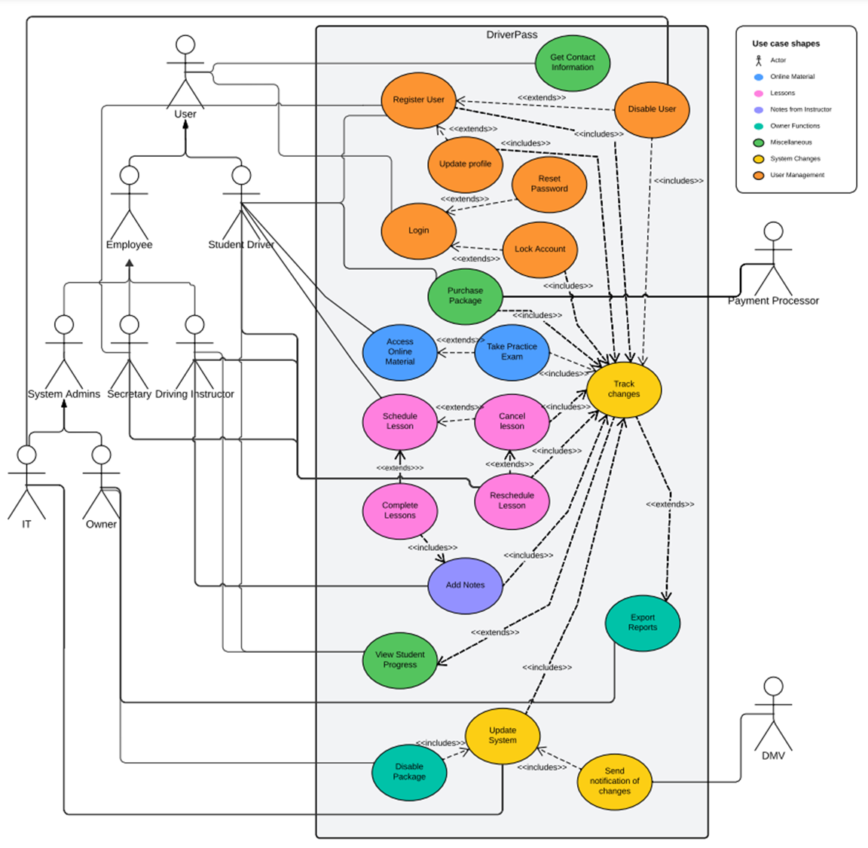
Use Case Diagram
[Insert your use case diagram here.]
Notes:
[Explain your diagram. Who are the different actors in the system? What are the different use cases? How did you account for DriverPass’s needs in your design? In your explanation, keep your audience in mind. Avoid the use of terms like “actors” and “use cases” in your explanation.]
There are many different types of people or organizations that will interact with the system. The people we envision interacting are the student driver and 4 different types of employees for DriverPass: the secretary, the owner, IT and driving instructors. We anticipate updates coming from the DMV and the need for a payment processing organization to handle transactions.
The tasks that will need to be completed within the system are: login, reset my password, unlock my account, lock account, disable account, purchase a package, access online material, take a practice exam, schedule driving lesson, cancel a lesson, reschedule a lesson, complete a driving lesson, add driver’s notes, export reports, disable packages, update the system, get contact information and track changes.
As you can see the system encompasses many tasks that the designers consider as they work to develop the system. These tasks and who needs access to them are outlined in the diagram so that we can ensure we meet all of your needs with our finished product.

Slide 4
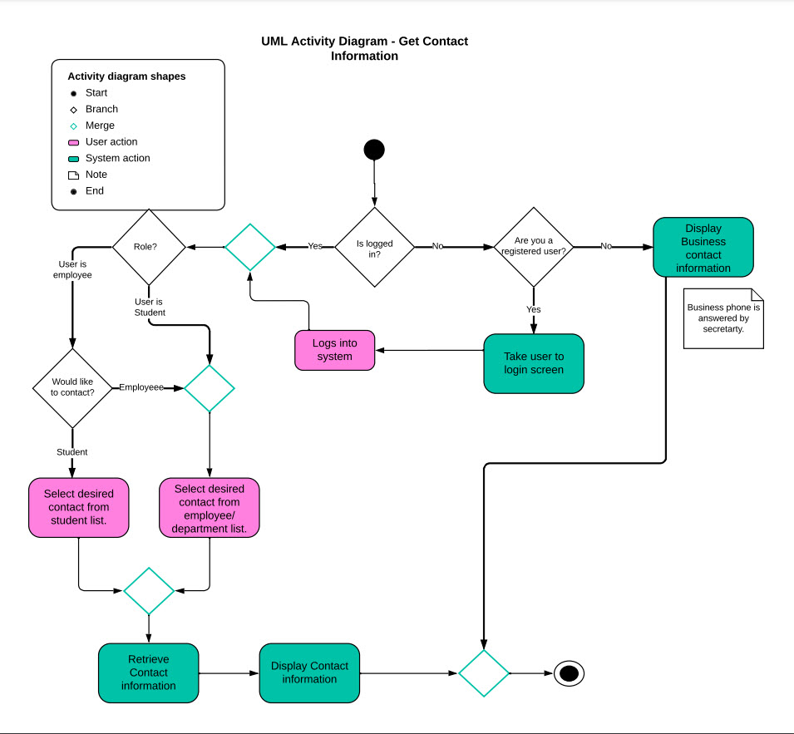
Activity Diagram
[Insert one of your activity diagrams here.]
Notes:
[Explain your diagram. Which use case are you breaking down? What are the steps for this use case? How did you account for DriverPass’s needs in your design? In your explanation, keep your audience in mind. Avoid the use of technical terms such as “nodes,” “control flows,” and so on.]
This diagram depicts the flow of activity as a user requests contact information. As you can see the role the user has in considered, this protects student information from being accessible to anyone other than staff on an active and logged in account. Customers who do not have a user account created only have access to the main business contact information. This activity starts with the user selecting get contact information. The system checks if the user is logged in, if not the system asks if they are a registered user. If the user does not already have an account they are provided with the business’ contact information. If the user has an account but is not logged in, they are taken to the login screen. Once logged in the system checks the role assigned to the user, if the user is a student they can select the staff member he or she needs to contact. If the user is an employee they are asked if they are looking for a student or an employee contact and are provided with the appropriate list to select from. Once the contact is selected their contact information is retrieved and displayed on the screen.

Slide 5
Security
Security focused design limits users to only accessing the minimum they need access to.
Two-factor authentication prevents “brute force” hacking attempts.
Accounts are locked after 3 unsuccessful password attempts and a notification is sent to the user.
The client server connection is secured using TLS1.3, the most secure to date.
Notes:
[How did you consider security in your design? In your explanation, keep your audience in mind by avoiding the use of technical terms.]
Security was considered in many ways. First by using the latest in client server security protocols TLS1.3 to safeguard communication. It is also addressed by ensuring dual=factor authentication, entering the correct username and password followed by a one-time use code sent to the user’s known email or phone number. User accounts are locked after 3 unsuccessful attempts and a notification is sent to the user. Credit card information is protected by only displaying the last 4 digits of a saved card’s numbers and by requiring the user to enter the correct security code each time they want to user the stored card. When a user attempts to perform a sensitive action the system checks that they are logged in, on a secure connection and have permission to perform the action prior to completing the action.

Slide 6
System Limitations
The system can’t be accessed without an internet connection.
The system will be limited in the amount of data stored by the size of storage purchased.
The system performance will be limited by internet bandwidth on both the server and client sides.
The project needs to stay within the budget to balance cost and revenue.
The project must adhere to the proposed schedule to avoid impacting projected revenue.
Notes:
[What are the limitations of your design? In your explanation, keep your audience in mind by avoiding the use of technical terms.]
Primarily the system is cloud-based so it is inaccessible without an internet connection but this is necessary as the IT required cloud-based so backups and security are handled by the provider. As an internet based service the speed and reliability of the system will be impacted by the quality of the internet connection on both the company’s end and the customer’s end. The size of the storage purchased will limit the amount of information the system can store. As with most projects time and budget are both factors that will limit the development of the DriverPass system. As these limitations are common in projects the design team is confident they can develop a system that meets your needs while respecting these limitations.

